Slide 1
Wi-Fi Alliance meeting
Thomas Weilacher Chairman ECC Working Group FM
Bucharest, 25 October 2017
1

Slide 2
Ongoing activities within CEPT/ECC on WAS/RLAN
Overview:
RLAN related topics
RLANs operating in vehicles
WAS/RLAN in 5925 – 6425 MHz
Interferences at meteorological radars in 5600 – 5650 MHz caused by 5 GHz WAS/RLAN
WRC-19 AI 1.16, CPG / PTD

Slide 3
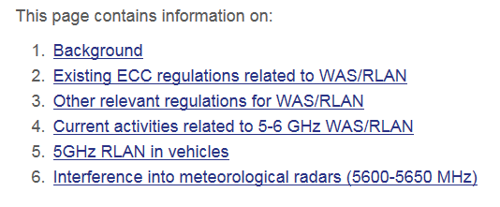
RLAN related topics
ECC website (topics): https://cept.org/ecc/topics/wireless-access-systems-and-radiolan-wasrlan

Slide 4
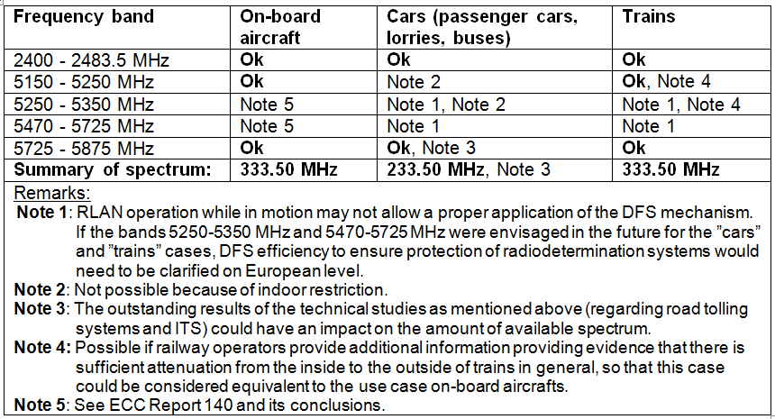
RLANs operating in vehicles
Explanatory paper: http://www.efis.dk/documents/44659

Slide 5
RLANs operating in vehicles (cont.)
CEPT SRD regulation within 5725 - 5875 MHz overlaps with the U-NII-3 regulation (up to 5825 MHz (centre frequency)). It is not known whether up to now a European mode has been implemented in the RLAN user equipment such as Smartphones, Tablets etc. which would enable channels 149 to 165 (centre frequencies from 5745 to 5825 MHz) for operation at maximum 25 mW e.i.r.p.
Within CEPT road tolling systems operate in the band 5795 - 5815 MHz. Technical investigations about SRD usage in cars equipped with 5.8 GHz road toll equipment, RLAN use based on the 5.8 GHz non-specific SRD regulation (25 mW e.i.r.p.), as well as co-channel ITS communications (5855 - 5875 MHz) are ongoing.

Slide 6
WAS/RLAN in 5925 – 6425 MHz
ECC#44 in March 2017 (Dublin) agreed on Work Item FM_52 (now Work Item FM57_01): “Develop an ECC Report on the technical and regulatory feasibility of the harmonised introduction of low power wireless access systems (including RLAN) in the band 5925 - 6425 MHz under a non-protected basis and ensuring certainty for continued operation, development and protection of existing primary services (FSS, FS) taking into account RR 5.440 and 5.458.”
WG FM #88 in May 2017 (Dublin) asked WG SE to carry out compatibility and sharing studies (Doc. FM(17)127 – Annex 38).
WG FM #89 in October 2017 (Zagreb) provided additional information to WG SE (Doc. FM(17)177 – Annex 19).

Slide 7
WAS/RLAN in 5925 – 6425 MHz (cont.)
Urban Rail systems are currently in operation in the range 5915 - 5935 MHz (in France and Spain) and in the range 5925 - 5975 MHz (in Denmark).
WG FM and SRD/MG are currently studying the extension of the band for safety-related ITS applications up to 5925 MHz (the band 5875 - 5905 MHz has been harmonised so far on CEPT and on EU level) and the inclusion of Urban Rail in 5875 - 5925 MHz. Therefore, by studying WAS/RLANs in the range 5925 - 6425 MHz, ITS (including Urban Rail) should be taken into account as an application in the adjacent band.
RSC#61 in October 2017 provided a positive opinion on a Mandate to CEPT on ITS (Doc. RSCOM17-26rev3).

Slide 8
WAS/RLAN in 5925 – 6425 MHz (cont.)
RSC#61 in October 2017 discussed a first draft Mandate on WAS/RLAN (5925 – 6725 MHz) to CEPT (doc. RSCOM17-40). Further discussions during RSC#62 in December 2017.
A new System Reference Document (TR 103 524) is under development within ETSI (TC BRAN).
Two new Project Teams have been established by WG FM and WG SE: FM57 and SE45.

Slide 9
Interferences at meteorological radars in 5600 – 5650 MHz
ECC#44 in March 2017 (Dublin) addressed the issue of Interference from 5 GHz RLAN to meteorological radars and agreed on an action plan (doc. ECC(17)034 – Annex 14).
ECC#44 also agreed that the current situation is not a consequence of any shortcomings in the Regulations (e.g. ECC Decision, EC Decision) or in the sharing mechanism in place (DFS, as specified in ETSI EN 301 893).
It was agreed that actions have to be undertaken within short-notice.
As part of the action plan WG FM #88 agreed on a questionnaire to administrations, the responses were analysed at WG FM#89 in October 2017.

Slide 10
Interferences at meteorological radars in 5600 – 5650 MHz (cont.)
WG FM #89 agreed to send a liaison statement to ADCO/RED (Doc. FM(17)177 - Annex 07) proposing to conduct a new market surveillance campaign for RLAN 5 GHz, considering various types of equipment, including a focus on equipment used for fixed outdoor installations.
A summary of discussions based on the replies of CEPT administrations to the questionnaire on interference cases (Doc. FM(17)177 - Annex 05) was provided in the annex to the liaison statement.
This information was also provided to the Joint RSC/TCAM meeting in October 2017 and will be provided to the forthcoming ECC meeting in November 2017.

Slide 11
Interferences at meteorological radars in 5600 – 5650 MHz (cont.)
Summary (overview):
37 CEPT administrations responded to the questionnaire, 24 of which reported around 554 interference cases of WAS/RLAN equipment into meteorological radars.
The replies submitted outline areas between WAS/RLAN equipment and meteorological radars ranging from hundred meters up to 181 km.
The interferences almost exclusively originated from WAS/RLAN equipment in fixed outdoor installations using directive antennas.

Slide 12
Interferences at meteorological radars in 5600 – 5650 MHz (cont.)
Summary (overview, cont.):
The answers have been mixed regarding the question whether the DFS mechanism of the WAS/RLAN equipment was inactive. The DFS mechanism was either active, inactive or inoperative and the provided information does not allow any conclusion whether the WAS/RLAN equipment was sometimes operated at higher emission levels than permitted under the current regulation.
Interference cases are for the most of it solved by reconfiguration of the WAS/RLAN equipment, e.g. change of operating channel, DFS activation, rebooting or firmware/software upgrades/removal of equipment malfunction.

Slide 13
Interferences at meteorological radars in 5600 – 5650 MHz (cont.)
Summary (overview, cont.):
There were a considerable number of short-term interference cases according to the reporting.
Difficult to count, because they were not reported to the relevant administration, or because they disappeared between the moment when they were identified and the moment in which their source could have been identified.
Short-term interference cases were mainly caused by emissions of end-user outdoor stations, while long-term interferences were mainly caused by emissions from RLAN access points used for infrastructure purposes.

Slide 14
WRC-19 AI 1.16, CPG / PTD
5150 - 5250 MHz: current studies show difficulties with incumbent services (aeronautical radionavigation, aeronautical telemetry and MSS feeder links).
5250 - 5350 MHz: current studies show difficulties with incumbent services (EESS active (altimeters and scatterometers), space research service, and radio location service).
5350 - 5470 MHz: CEPT supports no change to the RR in this band. Studies showed that sharing would not be feasible. No solution has been identified to protect fast frequency hopping and bi-static radars.

Slide 15
WRC-19 AI 1.16, CPG / PTD (cont.)
5725 - 5850 MHz: CEPT will take into account compatibility studies between RLAN and specific applications such as road tolling.
5850 - 5925 MHz: current studies have shown difficulties in achieving co-existence with incumbent services (FSS space station receivers) and existing applications under the mobile service such as ITS (including urban rail).

Slide 16
Finally..
Thank you very much
Further information on: www.cept.org/ecc

